Slide 1
CompTIA Security+ Guide to Network Security Fundamentals, Sixth Edition
Chapter 11
Authentication and Account Management

Slide 2
Objectives
11.1 Describe the different types of authentication credentials
11.2 Explain what single sign-on can do
11.3 List the account management procedures for securing passwords

Slide 3
Authentication Credentials (1 of 2)
Types of authentication credentials
Where you are
Example: a military base
What you have
Example: key fob to lock your car
What you are
Example: facial characteristics recognized
What you know
Example: combination to health club locker
What you do
Example: do something to prove authenticity

Slide 4
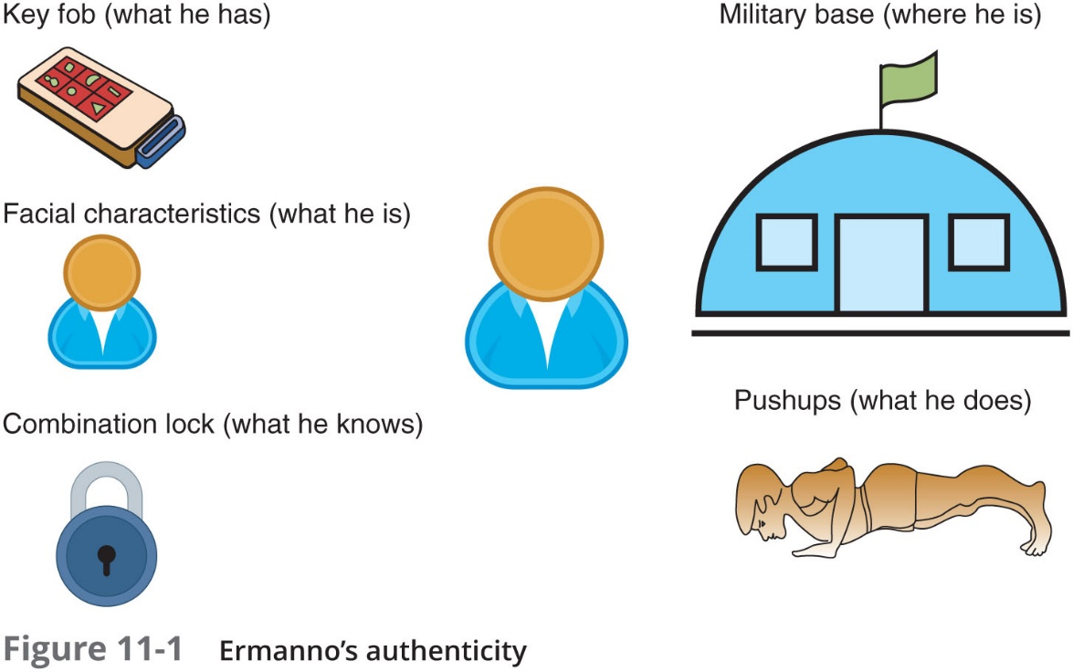
Authentication Credentials (2 of 2)

Slide 5
What You Know: Passwords
User logging in to a system
Asked to identify himself
User enters username
User asked to authenticate
User enters password
Passwords are the most common type of authentication today
Passwords provide only weak protection
Actions can be taken to strengthen passwords

Slide 6
Password Weaknesses (1 of 3)
Weakness of passwords is linked to human memory
Humans can memorize only a limited number of items
Long, complex passwords are most effective
Most difficult to memorize
Users must remember passwords for many different accounts
Each account password should be unique
Security policies mandate passwords must expire
Users must repeatedly memorize passwords

Slide 7
Password Weaknesses (2 of 3)
Users often take shortcuts
Using a weak password
Examples: common words, short password, or personal information
When attempting to create stronger passwords, they generally follow predictable patterns:
Appending: using letters, numbers, and punctuation in a pattern
Replacing: users use replacements in predictable patterns

Slide 8
Password Weaknesses (3 of 3)
Rank | Password
1 | 123456
2 | 123456789
3 | abc123
4 | password
5 | password1
6 | 12345678
7 | 111111
8 | 1234567
9 | 12345
10 | 1234567890

Slide 9
Attacks on Passwords (1 of 9)
Attacks that can be used to discover passwords:
Social engineering
Phishing, shoulder surfing, dumpster diving
Capturing
Keylogger, protocol analyzer
Man-in-the-middle and replay attacks
Resetting
Attacker gains physical access to computer and resets password

Slide 10
Attacks on Passwords (2 of 9)
Offline attack
Method used by most password attacks today
Attackers steal file of password digests
Compare with their own digests they have created
Offline password attacks include:
Brute force
Mask
Rule
Dictionary
Rainbow tables
Password collections

Slide 11
Attacks on Passwords (3 of 9)
Brute force
Every possible combination of letters, numbers, and characters used to create encrypted passwords and matched against stolen file
Slowest, most thorough method
N T L M (New Technology LAN Manager) hash
An attacker who can steal the digest of an N T L M password would not need to try to break it
He would simply pretend to be the user and send that hash to the remote system to then be authenticated
Known as a pass the hash attack

Slide 12
Attacks on Passwords (4 of 9)
Mask Attack
A more targeted brute force attack that uses placeholders for characters in certain positions of the password
Parameters that can be entered in a mask attack include:
Password length
Character set
Language
Pattern
Skips
Rule Attack
Conducts a statistical analysis on the stolen passwords that is used to create a mask to break the largest number of passwords

Slide 13
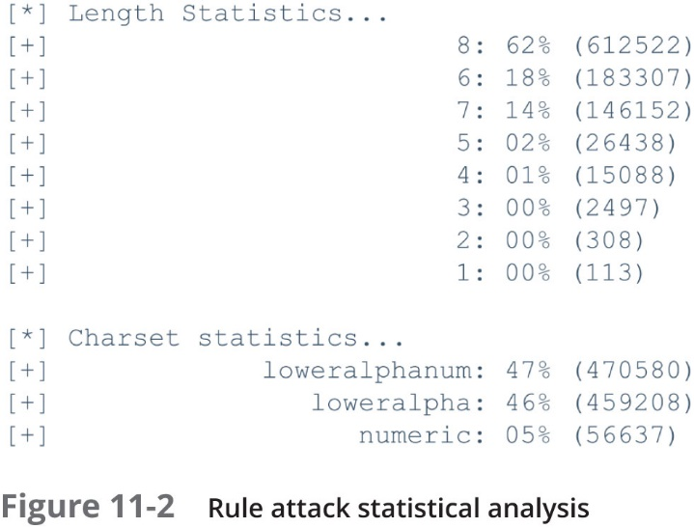
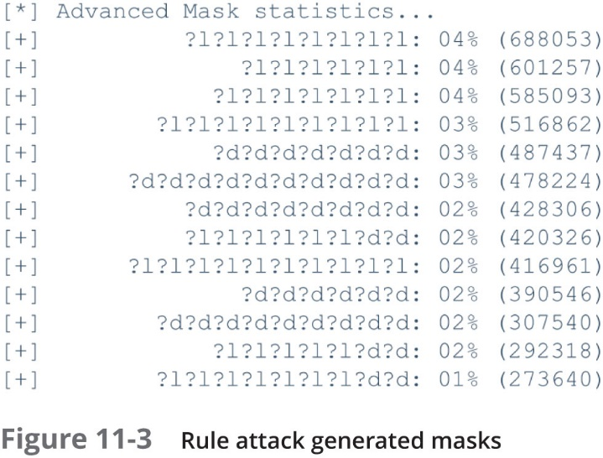
Attacks on Passwords (5 of 9)

Slide 14
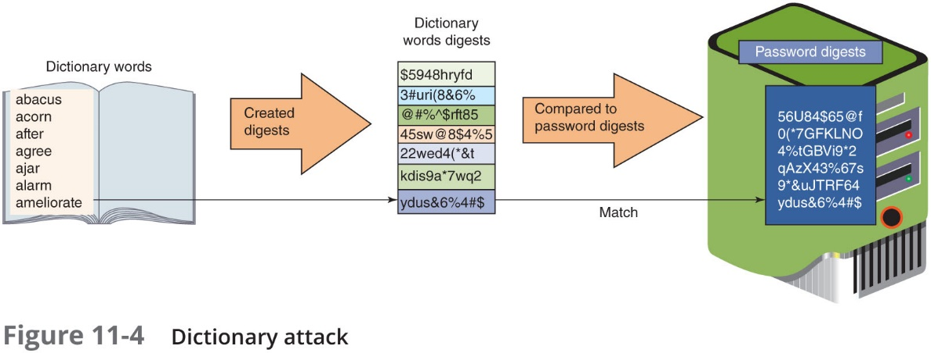
Attacks on Passwords (6 of 9)
Dictionary Attack
Attacker creates digests of common dictionary words
Compares against stolen digest file
Pre-image attack - a dictionary attack that uses a set of dictionary words and compares it with the stolen digests
Birthday attack - the search for any two digests that are the same

Slide 15
Attacks on Passwords (7 of 9)
Rainbow Tables
Creates a large pregenerated data set of candidate digests
Steps for using a rainbow table
Creating the table
Chain of plaintext passwords
Encrypt initial password
Feed into a function that produces different plaintext passwords
Repeat for a set number of rounds
Using the table to crack a password
Run encrypted password though same procedure used to create initial table
Results in initial chain password

Slide 16
Attacks on Passwords (8 of 9)
Using the table to crack a password (cont’d.)
Repeat, starting with this initial password until original encryption is found
Password used at last iteration is the cracked password
Rainbow table advantages over other attack methods
Can be used repeatedly
Faster than dictionary attacks
Less memory on the attacking machine is required

Slide 17
Attacks on Passwords (9 of 9)
Password Collections
In 2009, an attacker used an SQL injection attack and more than 32 million user passwords (in cleartext) were stolen
These passwords provided two key elements for password attacks:
Gave attackers a large corpus of real-world passwords
Have provided attackers advanced insight into the strategic thinking of how users create passwords

Slide 18
Password Security (1 of 5)
Securing passwords from attacks depends upon the user as well as the enterprise
For the user
It involves properly managing passwords
For the enterprise
It involves protecting password digests

Slide 19
Password Security (2 of 5)
Managing Passwords
Most critical factor in a strong password is length
In addition to having long passwords, other recommendations are:
Do not use passwords that consist of dictionary words or phonetic words
Do not repeat characters or use sequences
Do not use birthdays, family member names, pet names, addresses, or any personal information
Also, use non-keyboard characters
Created by holding down the ALT key while typing a number on the numeric keypad

Slide 20
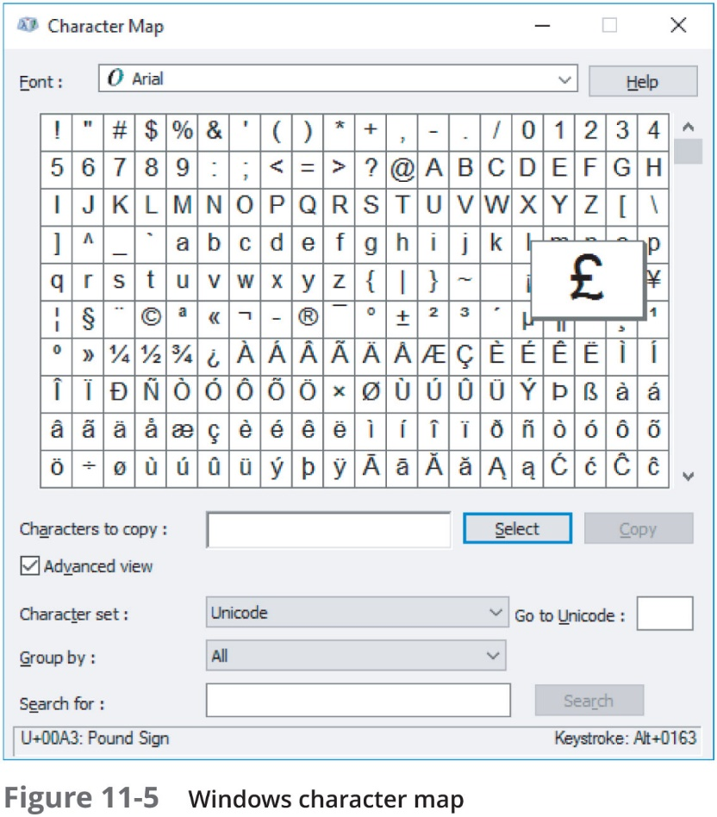
Password Security (3 of 5)

Slide 21
Password Security (4 of 5)
Password managers
Technology used for securing passwords
Three basic types of password manager:
Password generators
Online vaults
Password management applications
Protecting Password Digests
One method is to use salts
Consists of a random string that is used in hash algorithms
Passwords can be protected by adding a random strong to the user’s cleartext password before it is hashed
Make dictionary attacks and brute force attacks much slower and limit the impact of rainbow tables

Slide 22
Password Security (5 of 5)
Protecting Password Digests (continued)
Another method is to use key stretching
A specialized password hash algorithm that is intentionally designed to be slower
Two key stretching algorithms: brypt and P B K D F 2
Recommendation for enterprises using salts and key stretching:
Use a strong random number generator to create a salt of at least 128 bits
Input the salt and the user’s plaintext password into the P B K D F 2 algorithm that is using H M A C-S H A-256 as the core hash
Perform at least 30,000 iterations on P B K D F 2
Capture the first 256 bits of output from P B K D F 2 as the password digest
Store the iteration count, the salt, and the password digest in a secure password database

Slide 23
What You Have: Tokens, Cards, and Cell Phones
Multifactor authentication
When a user is using more than one type of authentication credential
Example: what a user knows and what a user has could be used together for authentication
Single-factor authentication
Using just one type of authentication
Most common items used for authentication:
Tokens, cards, and cell phones

Slide 24
Tokens (1 of 4)
Tokens
Used to create a one-time password (O T P)
Authentication code that can be used only once or for a limited period of time
Hardware security token
Typically a small device with a window display
Software security token
Stored on a general-purpose device like a laptop computer or smartphone
Two types of O T P s
Time-based one-time password (T O T P)
Synched with an authentication server
Code is generated from an algorithm
Code changes every 30 to 60 seconds

Slide 25
Tokens (2 of 4)
Two types of O T P s (continued)
HMAC-based one-time password (H O T P)
“Event-driven” and changes when a specific event occurs
Advantages over passwords
Token code changes frequently
Attacker would have to crack code within time limit
User may not know if password has been stolen
If token is stolen, it becomes obvious and steps could be taken to disable account

Slide 26
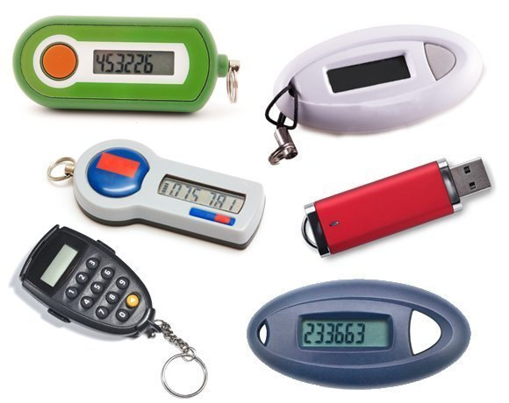
Tokens (3 of 4)

Slide 27
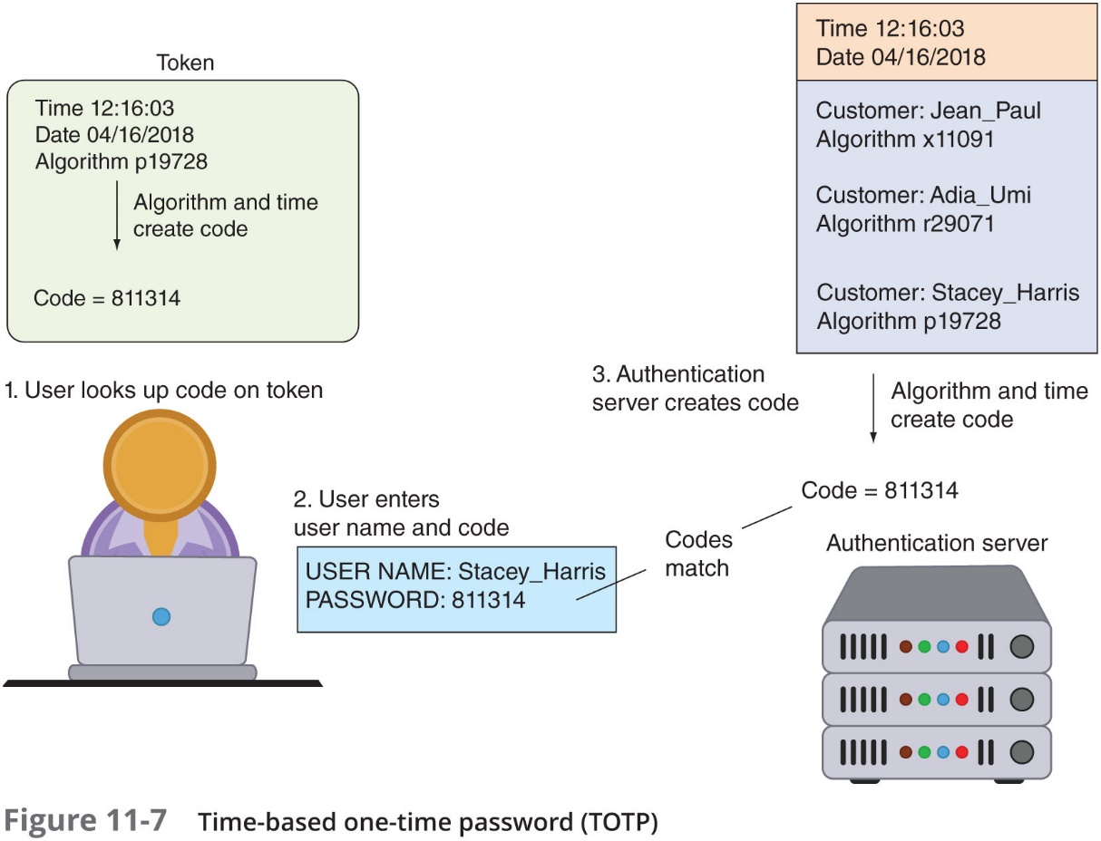
Tokens (4 of 4)

Slide 28
Cards (1 of 2)
Smart card contains integrated circuit chip that holds information and can be either:
Contact card – a “pad” that allows electronic access to chip contents
Contactless cards (proximity cards)
Require no physical access to the card
Common access card (C A C)
Issued by U S Department of Defense
Bar code, magnetic strip, and bearer’s picture
The smart card standard covering all U.S. government employees is the Personal Identity Verification (P I V) standard

Slide 29
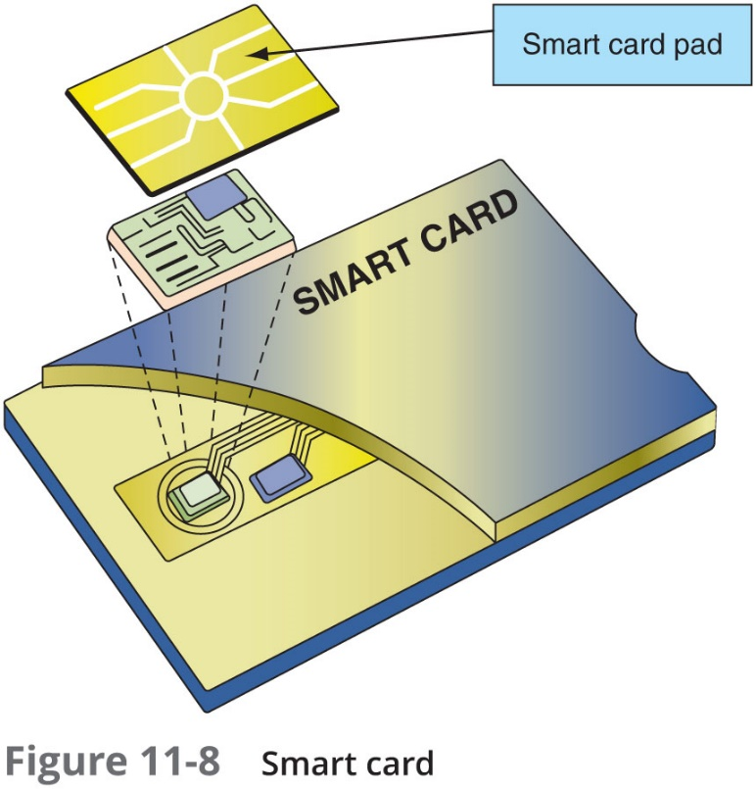
Cards (2 of 2)

Slide 30
Cell Phones
Cell Phones are increasingly replacing tokens and cards
A code can be sent to a user’s cell phone through an app on the device
Allow a user to send a request via the phone to receive an H O T P authorization code

Slide 31
What You Are: Biometrics
“Something you are” biometrics involves:
Standard biometrics
Cognitive biometrics

Slide 32
Standard Biometrics (1 of 4)
Standard biometrics
Uses a person’s unique physical characteristics for authentication
Face, hand, or eye characteristics are used to authenticate
Specialized Biometric Scanners
Retinal scanner uses the human retina as a biometric identifier
Maps the unique patterns of a retina by directing a beam of low-energy infrared light (I R) into a person’s eye
Fingerprint scanner types
Static fingerprint scanner - takes a picture and compares with image on file
Dynamic fingerprint scanner - uses small slit or opening

Slide 33
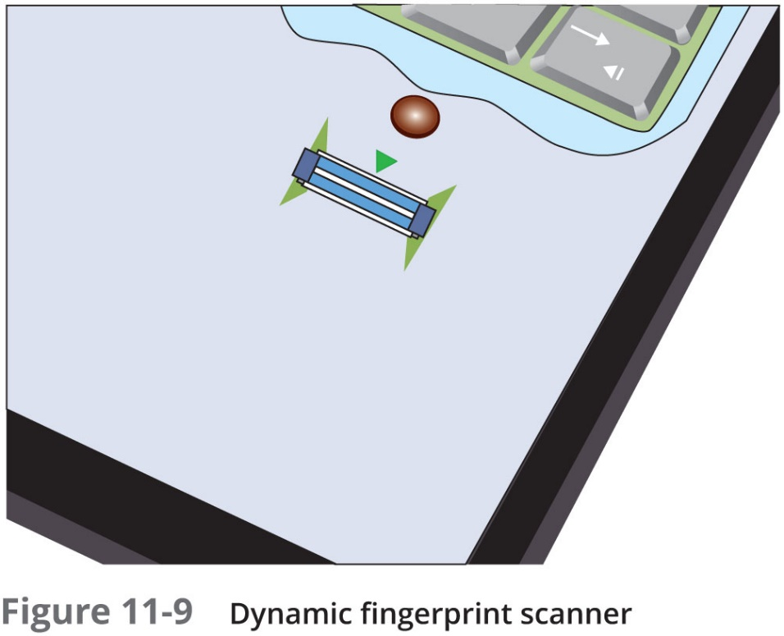
Standard Biometrics (2 of 4)

Slide 34
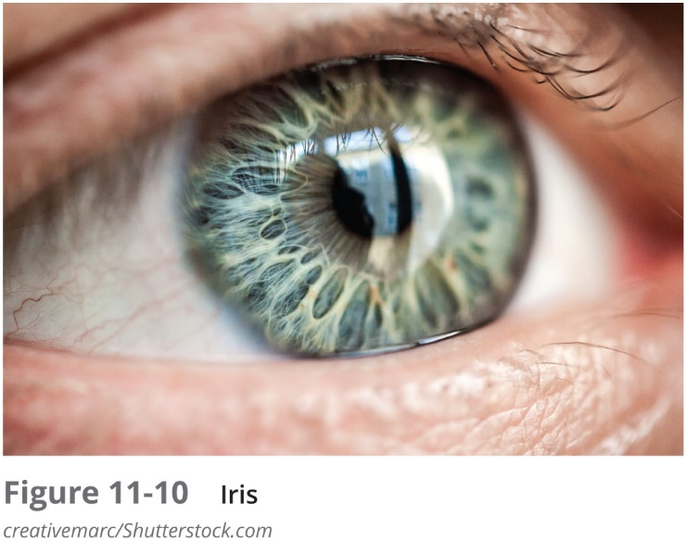
Standard Biometrics (3 of 4)
Standard Input Devices
Voice recognition uses a standard computer microphone to identify users based on the unique characteristics of a person’s voice
Iris scanner uses a standard webcam to identify the unique characteristics of the iris
Facial recognition uses landmarks called nodal points on human faces for authentication

Slide 35
Standard Biometrics (4 of 4)
Biometric Disadvantages
Cost of hardware scanning devices
Readers have some amount of error
Reject authorized users
Accept unauthorized users
Biometric systems can be “tricked”

Slide 36
Cognitive Biometrics (1 of 2)
Cognitive biometrics
Relates to perception, thought process, and understanding of the user
Easier for user to remember because it is based on user’s life experiences
Difficult for an attacker to imitate
Picture password/Picture Gesture Authentication (PGA)
Introduced by Windows
Users select a picture to use for which there should be at least 10 “points of interest” that could serve as “landmarks” or places to touch
Other examples of cognitive biometrics:
Requires user to identify specific faces
User selects one of several “memorable events”

Slide 37
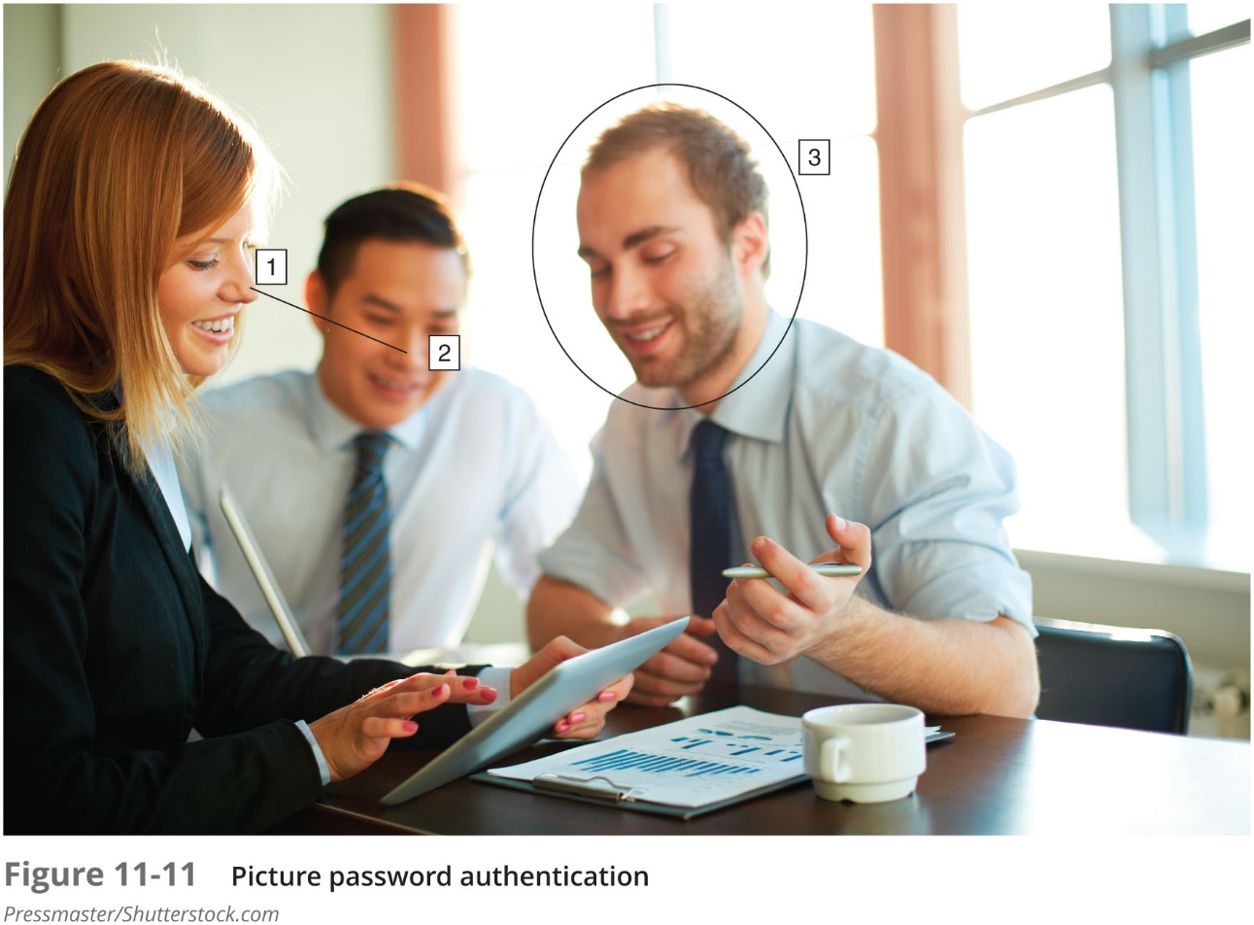
Cognitive Biometrics (2 of 2)

Slide 38
What You Do: Behavioral Biometrics (1 of 2)
Behavioral biometrics
Authenticates by normal actions the user performs
Keystroke dynamics
Attempts to recognize user’s typing rhythm
All users type at a different pace
Provides up to 98 percent accuracy
Uses two unique typing variables
Dwell time (time it takes to press and release a key)
Flight time (time between keystrokes)
Holds a great amount of potential
It requires no specialized hardware

Slide 39
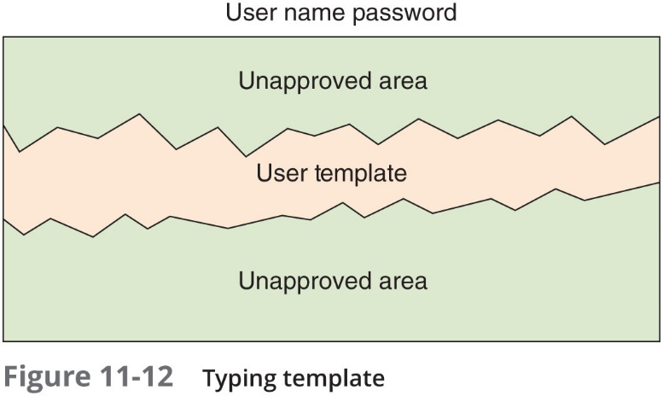
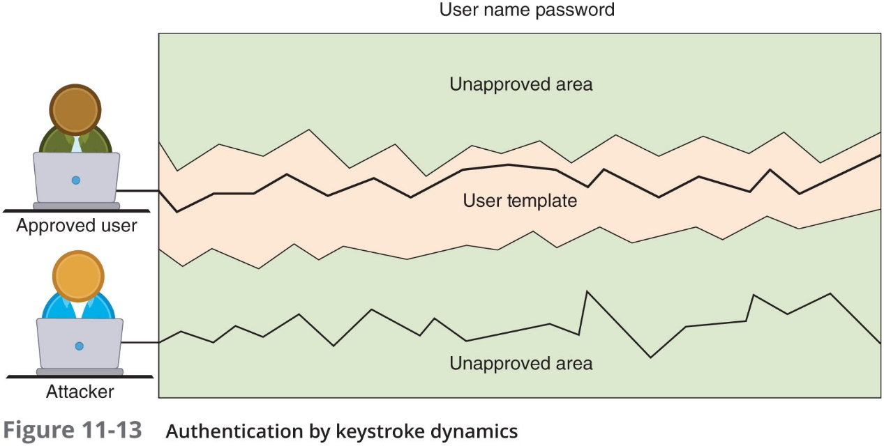
What You Do: Behavioral Biometrics (2 of 2)

Slide 40
Where You Are: Geolocation
Geolocation
The identification of the location of a person or object using technology
Used most often to reject imposters instead of accepting authorized users
Can indicate if an attacker is trying to perform a malicious action from a location different from the normal location of the user
Many websites will not allow a user to access an account if the computer is located in a different state
Some websites may require a second type of authentication
A code sent as a text message to a cell phone number on file

Slide 41
Single Sign-on
Identity management
Using a single authentication credential shared across multiple networks
It is called federated identity management (FIM) when networks are owned by different organizations
Single sign-on (S S O) holds promise to reduce burden of usernames and passwords to just one
Examples of popular S S O s:
OAuth, Open ID Connect, and Shibboleth

Slide 42
Account Management (1 of 2)
Managing user account passwords
Can be done by setting password rules
Too cumbersome to manage on a user-by-user basis
Security risk if one user setting is overlooked
Preferred approach: assign privileges by group (group policy)
Microsoft Windows group password settings
Password Policy Settings
Account Lockout Policy

Slide 43
Account Management (2 of 2)
Other steps to take:
A shared account, a generic account, and a guest account should be prohibited
Closely monitor any privileged accounts
Disable account passwords instead of deleting accounts no longer being used
Create strict policies regarding password recovery
Transitive trust
A two-way relationship that is automatically created between parent and child domains in a Microsoft Active Directory Forest
When a new domain is created, it shares resources with its parent domain by default
Can enable an authenticated user to access resources in both the child and the parent

Slide 44
Review Questions
Which authentication factor is based on a unique talent that a user possesses?
A. What you have
B. What you are
C. What you do
D. What you know
What is a token system that requires the user to enter the code along with a PIN called?
A. Single-factor authentication system
B. Token-passing authentication system
C. Dual-prong verification system
D. Multifactor authentication system
Using one authentication credential to access multiple accounts or applications is known as _____.
A. single sign-on
B. credentialization
C. identification authentication
D. federal login

Slide 45
Chapter Summary (1 of 2)
Authentication credentials can be classified into five categories: what you know, what you have, what you are, what you do, and where you are
Passwords provide a weak degree of protection
Must rely on human memory
Most password attacks today use offline attacks
Attackers steal encrypted password file
A dictionary attack begins with the attacker creating digests of common dictionary words, which are compared with those in a stolen password file
Securing passwords from attacks depends upon the user as well as the enterprise
Security experts recommend that technology be used to store and manage passwords called password managers

Slide 46
Chapter Summary (2 of 2)
Another type of authentication credential is based on the approved user having a specific item in her possession
A hardware token is a small device that generates a code from an algorithm once every 30 to 60 seconds
Biometrics bases authentication on characteristics of an individual
Standard and cognitive biometrics are examples
Behavioral biometrics authenticates by normal actions the user performs
Single sign-on (S S O) allows a single username and password to gain access to all accounts
Group Policy settings allow an administrator to set password restrictions for an entire group at once

